Slide 1
Malaria Detection
Using Deep Learning and Convolutional Neural Networks to create a computer vision model to cost effectively detect malaria
By James Hochleutner

Slide 2
Executive Summary
Malaria is a deadly disease that is transmitted by infected mosquitos in predominantly warmer regions of the planet
Early and low-cost detection is essential in reducing malaria mortality
Traditional malaria detection techniques are expensive and require evaluation of a blood sample by an experienced professional
Anti Malaria medication is safe, effective, and widely available
Our Computer Vision Model, trained by scanning labeled images of healthy and infected blood samples, can detect malaria quickly, at scale, and at low cost
No need for a lab technician to evaluate each individual sample
99% accuracy with a model that can be trained in under 20 seconds
Key next step: Develop tools able to capture blood samples from patients and easily covert them to images for malaria detection

Slide 3
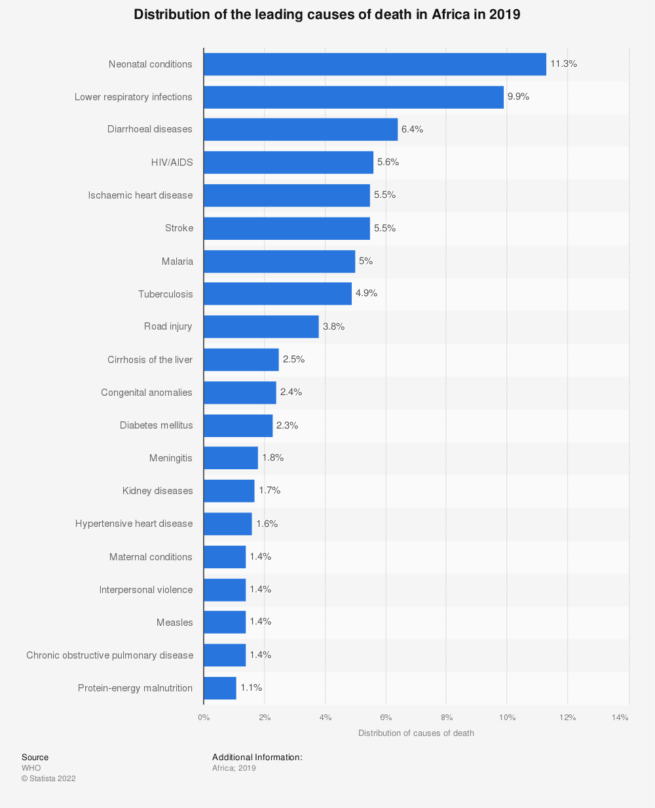
A Deadly Disease
Malaria is the leading cause of death in many countries with over 95% of cases and 96% of deaths occurring in Africa¹
The CDC estimates that malaria caused 229 million clinical episodes in 2019 and 400,000 deaths²
Early and low-cost detection is essential in reducing malaria mortality

Slide 4
Problem Definition & Key Objectives
Objectives
Create a computer vision model to detect malaria from the image of a patient’s red blood cell.
Reduce the cost and increase speed of detection
Create a flexible model that can be trained quickly on multiple image types/sizes, without the need for high powered computers or high-speed internet connections
Key Questions
Can we develop a machine vision model that is accurate and reliable in order to improve patient outcomes leaving the population with confidence that their diagnosis is accurate?
Will a machine learning model be too computationally intensive to be used in the field?
How can samples be taken and transformed quickly and cost effectively?

Slide 5
Proposed Solution
Model Structure
Model Tuning and Evaluation
We will start by creating a Convolutional Neural Network (CNN) with multiple layers Convolutional layers, pooling layers, ReLU layers, Fully connected layers, and Loss layers
Our machine learning model will scan each image in small batches of pixels in order to find patterns among the Parasitized and Uninfected images
In order to prevent model over fitting we will use Loss layers (dropout) to penalize parameters, early stopping, and we will ensure that we do not see a significant deterioration in model accuracy between the training and testing datasets
We will try multiple model constructions and hyper tune our parameters to optimize our model
Since malaria is a potentially deadly disease, it is more important for us to prioritize identifying infected patients knowing that this might lead our model to more frequently falsely identify some patients as Parasitized when they are actually Uninfected.

Slide 6
Refined Insights
Parasitized cells show a distinctive small circular shape within the red blood cell due to dye applied to samples
Most cells are circular in shape so image rotation would be unlikely to improve model training and performance
Convolutions Neural Networks are adept at learning the data sets they are trained on. Their strength and speed of learning, can also be a weakness leading to model over fitting

Slide 7
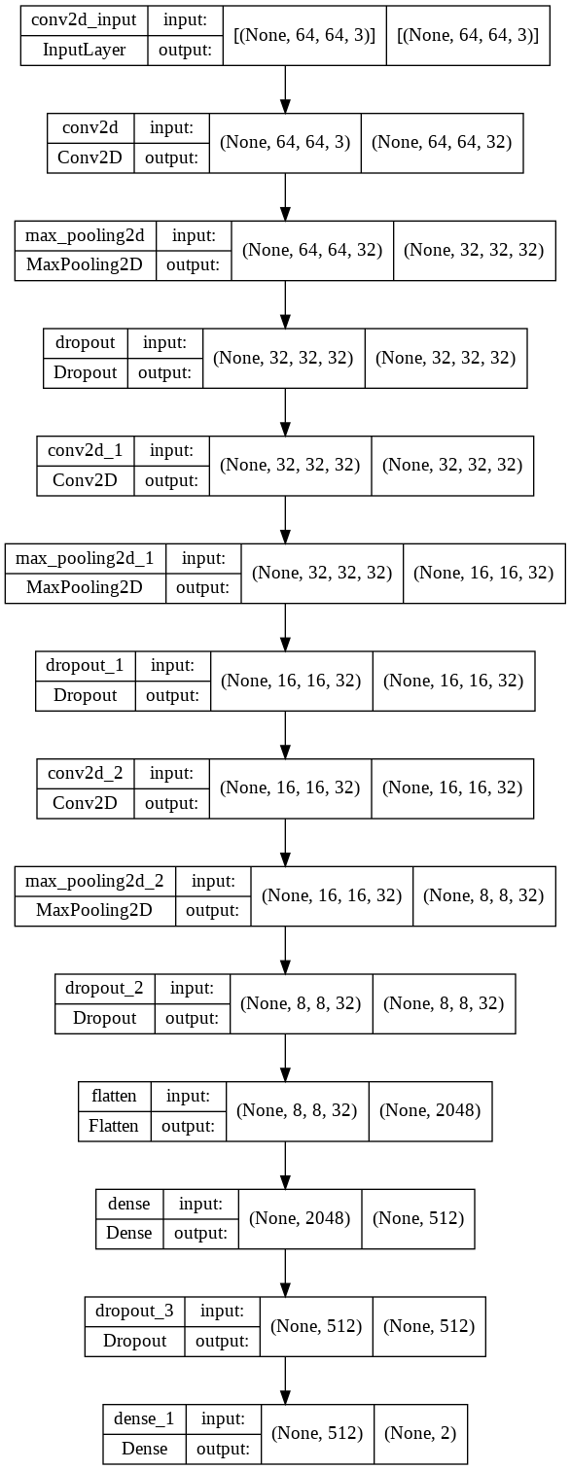
Base Model
Our Base model is a Sequential CNN with 17 layers
The model uses 2 dimensional convolutional layers to slide over the images. We can specify and iterate the number of filters in these layers. The more filters and layers we add, the more parameters the model will train on
Max Pooling layers help identify the most present features in each patch
Dropout layers randomly ignore some of the output layers, which adds noise to the training process, which helps with potential overfitting and ultimately makes the model more robust
Our final layer is a Softmax activation layer with 2 potential outputs, parasitized or uninfected

Slide 8
Beauty in simplicity
Reducing Model Complexity
A model with fewer layers, fewer filters per layer, and smaller batch sizes performed better than our Base Model
Attempts to increase model performance further by introducing bias regularizers failed to improve model performance
Through a process of iteration of filters per layer, and batch sizes, and attempts to add back Batch Normalization we were able to improve model accuracy as compared to the Base Model
Increasing Model Complexity
Our Base Model performed extremely well with 98.3% overall model accuracy, and only 33 cases of failing to identify a parasitized sample
Adding additional activation layers to our base model did not improve model accuracy, and model performance began to decline with longer training, suggesting potential model over fitting
Next we tried adding Batch Normalization layers, LeakyRelu activation function to standardize the inputs of each layer, removing the dropout layers since Batch Normalization already produces some regularization effects, and increasing the learning rate. This approach showed slight improvements
Image augmentation techniques did not degrade or improve model performance, but did increase training time
A pre-trained VGG-16 model with over 14 million trainable parameters performed far worse than our base model, suggesting that perhaps increasing model complexity would not lead to better performance

Slide 9
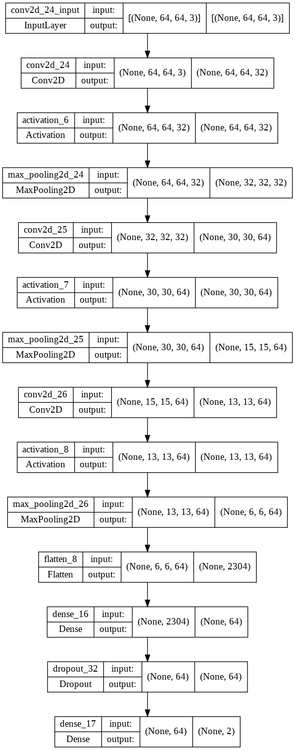
Final Model
Fewer layers (14), and fewer trainable parameters (203,970) led to higher accuracy, and faster performance
98.8% accuracy on the test set with only 10 cases of failing to identify parasitized samples
Can be trained in under 20 seconds
Performed well when trained with HSV, Gaussian Blurred, or larger image formats ensures flexibility in the field
Trained in under 20 seconds using a cloud-based server, and is simple enough to be trained on a low-cost laptop computer

Slide 10
Implementation
Cooperate
Cooperate with Governments and NGO’s for quick and broad rollout in Africa
Partner
Partner with Medical Device Companies to develop tools for image generation
Conduct
After implementation conduct a random audit to verify accuracy
Work
Work to compile a larger labeled dataset to help improve accuracy

